Slide 1


ON-LINE HELP DESK
Guided By : Work Done By:
Dr.M.Buvanesvari P. Umesh Kondappa
(Course Faculty) (192111346)
Programming in Java Computer science engineering
Saveetha School of Engineering Saveetha School of Engineering

Slide 2
ABSTRACT
With the goal of creating a Java applet for a "On-Line Help Desk" system, this project aims to improve customer satisfaction through the simplification and efficiency of the technical assistance process.
The main goal is to give consumers an easy-to-use interface via which they can track their progress, submit help requests, and interact in real time with support personnel.
Through features like ticket management, prioritizing, agent assignment, and escalation procedures, it also makes quick issue resolution possible.
Moreover, the possibility of having a knowledge base or FAQ part gives users the ability to access self-help tools and maybe handle common problems on their own.
The ultimate goal of this project is to close the communication gap that exists between users and support personnel in order to provide a more effective and timely environment for handling technical questions.

Slide 3
INTRODUCTION
Offering quick and effective support services is essential for businesses to keep customers happy and loyal in today's fast-paced digital environment.
The foundation for promptly and efficiently handling user-posted questions, concerns, and technical issues is a "On-Line Help Desk" system.
As software systems and technology get more complicated, consumers frequently run into problems that call for professional advice and support.
Thus, it is crucial to provide a user-friendly platform that makes asking for assistance easier and allows for smooth communication between users and support personnel.
The goal of this project is to create a Java-based "On-Line Help Desk" system that enables users to communicate with support agents in real-time, track the progress of their requests, and submit help requests.

Slide 4
BENEFITS
Improved Customer Service
Efficient Ticket Management
Cost Savings
Enhanced Communication
Knowledge Management
Data Analysis
Scalability
Increased Productivity
24/7 Accessibility
Improved Customer Retention

Slide 5
PROBLEM STATEMENT
The online help desk is currently facing significant challenges that impede its effectiveness and customer satisfaction.
These challenges include high ticket volumes, inefficient ticket routing, inadequate self-service options, poor communication between support agents and customers, and limited integration capabilities
These issues result in longer resolution times, increased customer frustration, and decreased productivity.
Addressing these challenges is essential to optimize the help desk system, streamline support processes, and ultimately improve the overall quality of service provided to customers.

Slide 6
PROBLEM IDENTIFIED
High Ticket Volume: If the help desk is overwhelmed with tickets, it can lead to delays in response times and decreased customer satisfaction.
Inefficient Ticket Routing: Tickets may not be properly routed to the appropriate support agents or teams, leading to confusion and longer resolution times.
Lack of Self-Service Options: If customers cannot find answers to their questions through self-service options like FAQs or knowledge bases, they are more likely to submit tickets, increasing the workload for support agents.
Poor Communication: Inadequate communication between support agents and customers can result in misunderstandings, frustration, and dissatisfaction.
Lack of Analytics: Without proper analytics and reporting capabilities, it can be challenging to identify trends, measure performance, and make data-driven improvements.

Slide 7
WORKING INTERFACE
1. User-Friendly Design: The interface should be intuitive and easy to navigate, allowing users to access different components of the research process seamlessly.
2. Clear Navigation: Clearly labeled sections or tabs for each component (e.g., problem identification, literature review, methodology) enable users to move between different stages of the research process efficiently.
3. Visual Representation: Incorporating visual elements such as flowcharts, diagrams, or timelines can help users visualize the sequential flow of the research process and understand the relationships between different components.
4. Interactive Features: Interactive features such as drop-down menus, checkboxes, or sliders can enhance user engagement by allowing them to customize their research parameters or preferences within the interface.

Slide 8
EXISTING SYSTEM
The existing system typically consists of separate tools and platforms for each component of the research process, such as problem identification, literature review, methodology development, data collection, analysis, and interpretation. Researchers often rely on a combination of software applications, online databases, and manual methods to conduct their research.
This fragmented approach can lead to inefficiencies, inconsistencies, and challenges in managing the research process effectively. Additionally, collaboration and communication among researchers may be limited, leading to coordination issues and potential duplication of efforts.

Slide 9
PROPOSED SYSTEM
Intuitive User Interface: Design a user-friendly interface that simplifies the ticket submission process for customers and provides clear navigation for support agents. A clean and intuitive layout enhances user experience and increases efficiency.
Smart Ticket Routing: Implement an intelligent ticket routing system that automatically assigns tickets to the most appropriate support agent or team based on factors such as expertise, workload, and priority level. This ensures faster response times and optimized resource allocation.
Comprehensive Knowledge Base: Develop a robust knowledge base with up-to-date articles, FAQs, tutorials, and troubleshooting guides to empower customers to resolve issues independently. Regularly update and expand the knowledge base to address common queries and emerging issues effectively.
Integrated Communication Channels: Offer multiple communication channels such as live chat, email, and phone support, seamlessly integrated within the help desk platform. This enables customers to choose their preferred method of communication while ensuring that all interactions are tracked and managed efficiently within the system.

Slide 10
ADVANTAGES
Accessibility
Efficiency
Cost-effectiveness
Scalability
Improved Customer Satisfaction
Centralized Knowledge Base
Data-driven Insights
Enhanced Communication

Slide 11
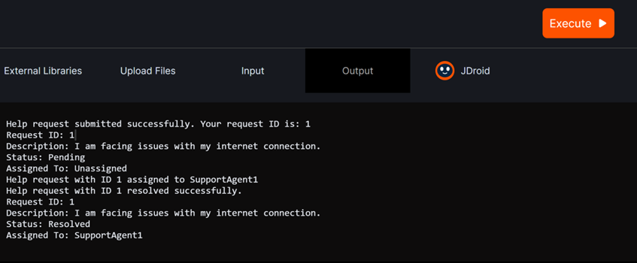
OUTPUT

Slide 12
FUTURE ENHANCEMENT
AI-Powered Chatbots: Implement advanced AI-driven chatbots to provide instant responses to common customer inquiries, freeing up human agents to focus on more complex issues. These chatbots can leverage natural language processing (NLP) and machine learning algorithms to understand and respond to customer queries accurately.
Predictive Analytics: Integrate predictive analytics capabilities into the help desk system to anticipate customer needs and proactively resolve issues before they arise. By analyzing historical data and customer behavior patterns, the system can predict potential issues, recommend solutions, and offer personalized assistance, enhancing the overall customer experience.
Omni-channel Support: Enhance omni-channel support capabilities to provide seamless and consistent experiences across multiple communication channels, including social media, messaging apps, and voice assistants. This ensures that customers can interact with the help desk through their preferred channels and receive consistent support regardless of the platform.

Slide 13
CONCLUSION
To sum up, creating a Java applet for a "On-Line Help Desk" system offers a reliable way to make technical help and user support easier.
Through the use of intuitive interfaces and instantaneous communication features, the applet expedites the process of submitting support requests, monitoring their progress, and corresponding with support personnel efficiently.
Crucial functionalities including ticket management, prioritizing, support agent assignment, and escalation protocols guarantee that pressing problems are attended to and resolved promptly.
Moreover, adding a knowledge base or frequently asked questions area enables users to solve typical issues on their own, decreasing reliance on support personnel and raising general customer satisfaction.

Slide 14


